Slide 1
Introduction to Model Deployment
From Notebook to Production

Slide 2
CONTENTS
What We'll Cover
01
02
Foundation
Deployment Methods
Why deployment matters and what it really means
Batch, real-time API, and embedded approaches
03
04
FastAPI Framework
Environments & Challenges
Why FastAPI and how to structure a deployment flow
Where models live and what can go wrong

Slide 3
FOUNDATION
Why Model Deployment Matters
Half the Job
Real Value
The Bridge
Building a model is only half the work. The real challenge is integrating it into production systems where it can be used reliably at scale.
Value is only created when models run in live systems — making predictions that directly inform business decisions and user experiences.
Deployment bridges the gap between data science and business applications, transforming research artifacts into operational, actionable tools.

Slide 4
FOUNDATION
What Is Model Deployment?
Model deployment is the process of integrating a trained machine learning model into a production environment so it can make predictions on real, live data.
This critical phase transforms experimental models into operational systems. Deployment encompasses not just technical integration, but also scalability, reliability, and maintainability — ensuring the model continues to deliver value long after the initial release.

Slide 5
FOUNDATION
Prototype vs. Production
Prototype
Production
Runs locally on a development machine
Requires manual execution and intervention
No scalability or load considerations
Limited testing and single-user environment
Automated processes and scheduled workflows
Scales to handle varying and peak loads
Continuously monitored and reliable
Comprehensive testing, multi-user, enterprise-ready

Slide 6
DEPLOYMENT METHODS
Ways to Deploy a Model
Three primary strategies — each suited to a different use case and latency requirement.

Slide 7

DEPLOYMENT METHODS
Three Core Deployment Approaches
1
2
3
Batch Deployment
Real-Time API
Embedded Deployment
Processes data in scheduled intervals — hourly, daily, or on-demand. Predictions are generated in bulk and stored for downstream consumption. Best for non-time-sensitive workloads like churn scoring or demand forecasting.
Delivers instant predictions via an HTTP API endpoint. Can be standalone or integrated into existing systems. Ideal for fraud detection, recommendation engines, and any use case requiring immediate results.
The model is packaged directly into a device or application — running locally on mobile hardware or edge devices without requiring an internet connection. Common in computer vision and NLP on-device applications.

Slide 8
FRAMEWORK
Introduction to FastAPI
FastAPI is a modern, high-performance Python framework for building APIs with automatic documentation and type validation — and the preferred tool for ML model deployment.

Slide 9



FRAMEWORK
Why FastAPI?
High Performance
Automatic Documentation
Easy ML Integration
Among the fastest Python frameworks — on par with NodeJS and Go. Asynchronous request handling ensures efficient concurrency, making it ideal for high-traffic ML APIs.
OpenAPI-compliant docs are generated automatically. Developers get Swagger UI and ReDoc out of the box — no extra effort required for testing or integration.
Works seamlessly with scikit-learn, TensorFlow, and PyTorch. Pydantic models provide automatic data validation, reducing runtime errors in production pipelines.

Slide 10
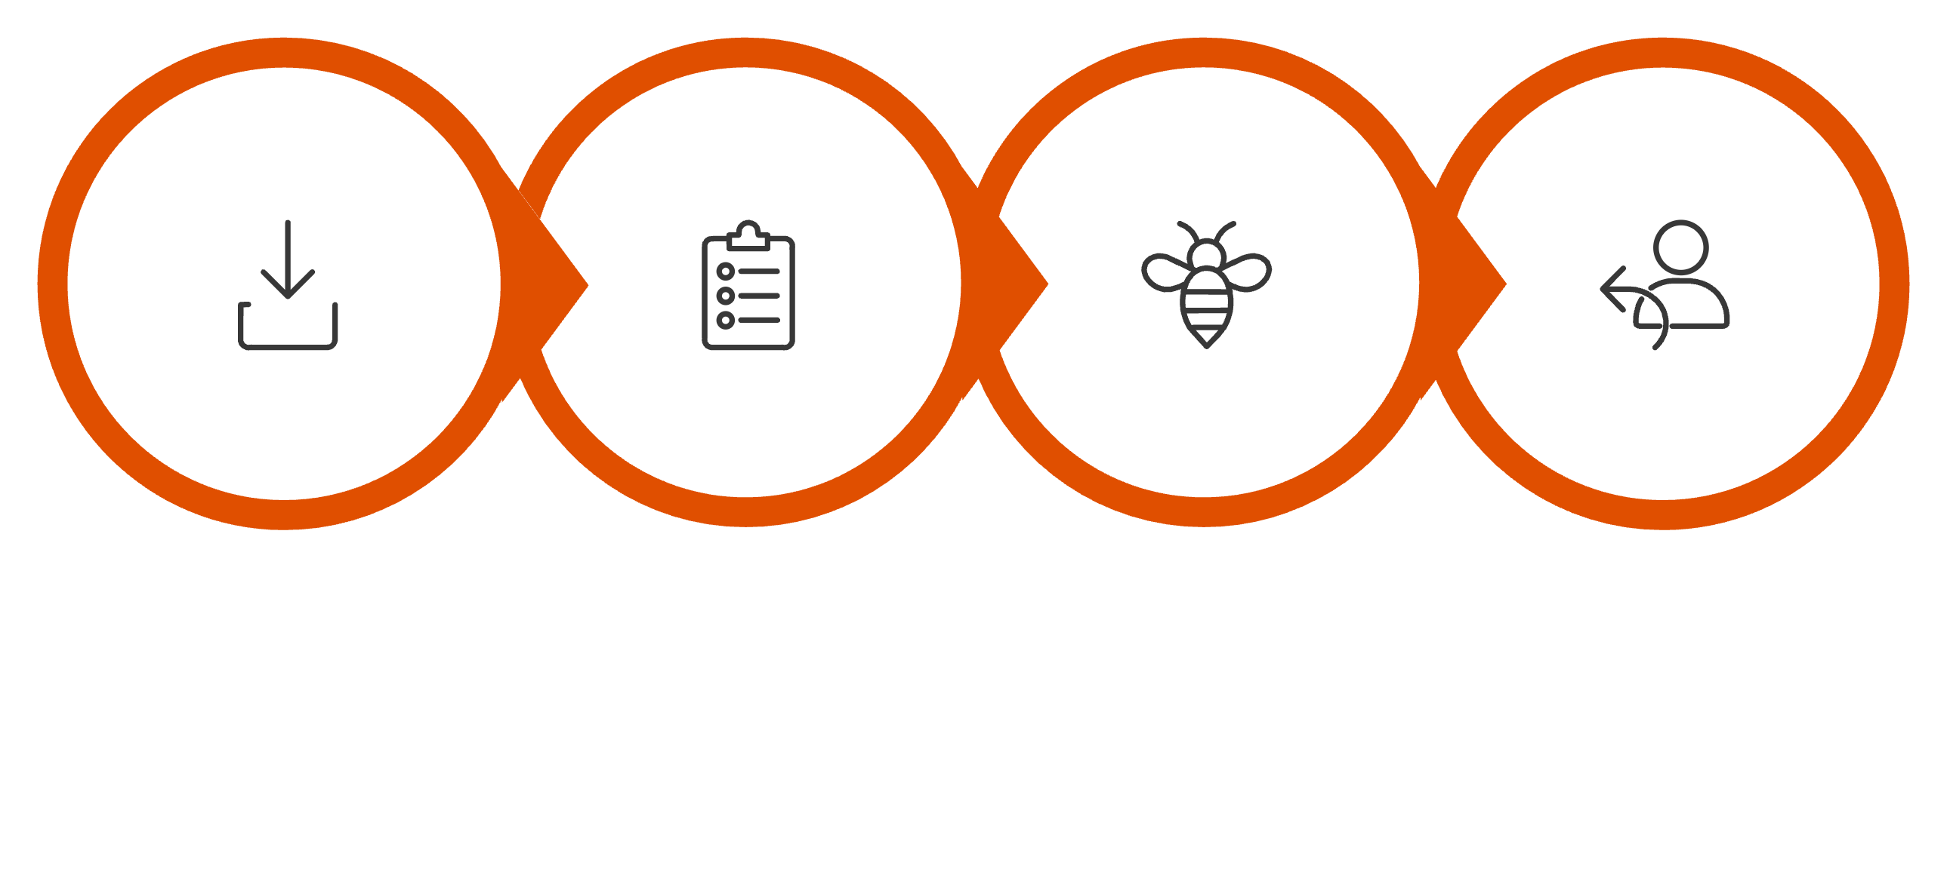
FRAMEWORK
FastAPI Deployment Flow
Define Schema
Create Endpoint
Return Predictions
Load Model
This four-step pattern is the standard structure for any FastAPI-based ML deployment — from loading a serialized model to serving validated, structured predictions.

Slide 11
FRAMEWORK
Other Python Deployment Options
Flask
Django
Streamlit
Gradio
Lightweight micro-framework. Simple and flexible for small to medium deployments with minimal overhead.
Full-featured framework with built-in admin panel and ORM. Best for larger applications needing more structure.
Rapid prototyping for interactive ML dashboards and demos. Not suited for production APIs.
Quick UI builder for ML models with minimal code. Great for sharing models with non-technical stakeholders.
MLflow
End-to-end ML lifecycle management — covers experiment tracking, model registry, and deployment.

Slide 12

ENVIRONMENTS
Where Models Get Deployed
Local Server
Cloud Platforms
Development and testing on local machines. Ideal for prototyping and initial validation before any production release.
Scalable deployment on AWS, Azure, or GCP. Offers managed services, global availability, and pay-as-you-go pricing.
On-Premise
Docker Containers
Deployed on the organization's own infrastructure. Full control over hardware and data governance — but requires dedicated maintenance.
Containerized deployment ensures consistency across environments. Simplifies dependency management and supports microservices architectures.

Slide 13
CHALLENGES
What Can Go Wrong in Production
Data Drift
Security
Input distribution shifts over time, silently degrading model accuracy without obvious errors.
Models and data must be protected from unauthorized access and adversarial inputs.
Scalability
Versioning
Systems must handle load spikes gracefully — from near-zero traffic to sudden peak demand.
Managing multiple model versions and ensuring seamless, zero-downtime transitions between updates.
Latency
Monitoring
Response time requirements demand careful optimization of inference pipelines and infrastructure.
Continuous tracking of model performance, system health, and downstream business metrics is essential.

Slide 14

KEY TAKEAWAYS
What to Remember
1
2
Deployment Makes Models Usable
APIs Are the Standard
ML value is only realized in production. A model that never deploys has zero business impact.
API-based deployment enables seamless integration with existing apps — supporting both real-time and batch prediction.
3
4
FastAPI Is a Preferred Tool
Deployment Is Continuous
High performance, auto-docs, and native ML library support make FastAPI the leading choice for production model APIs.
It's not a one-time event. Monitoring, retraining, versioning, and improvement are ongoing responsibilities.

